Slide 1

The Danish Game Factory
VR & Applied Games
Notes:
VR? Producing interactive VR experiences? Applied Games and their future? Applied VR Games? Examples?

Slide 2
- The Game industry -

Slide 3




The Game Industry
Notes:
Twice the revenue of the movie industry
New AppStore release every minute
The average gamer is 37 years old
1.5 billion players
8% yearly growth rate
48% female

Slide 4
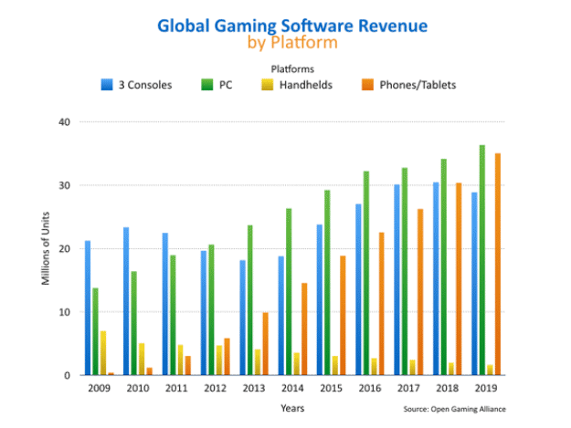
The game industry
Notes:
2016 - Oculus: 350.000, Vive: 450.000, PlayStation: 750.000, GearVR: 2.300.000

Slide 5
- VR -

Slide 6
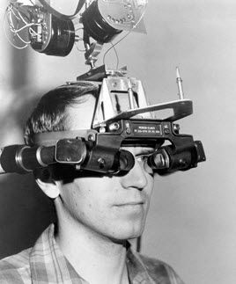
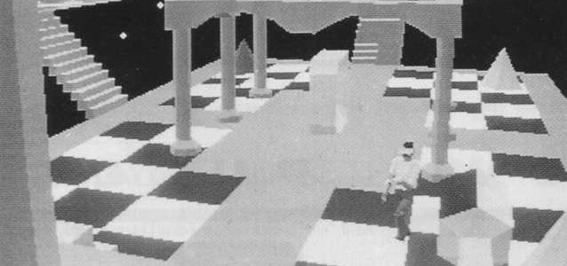
The sword of damocles - 1968

Slide 7
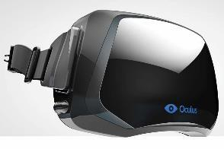
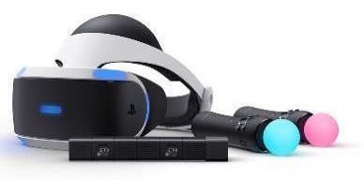
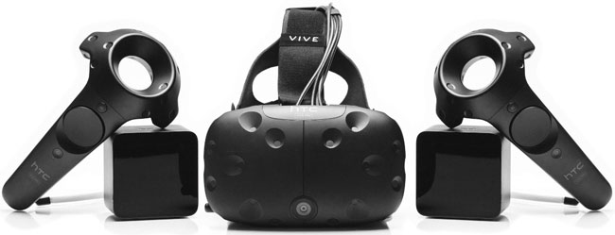
High end products

Slide 8
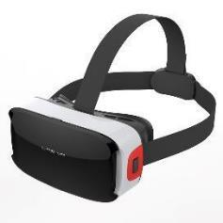
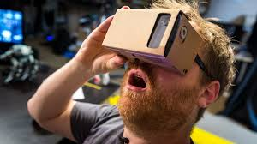

Low end products
Notes:
Smartphones, ling

Slide 9
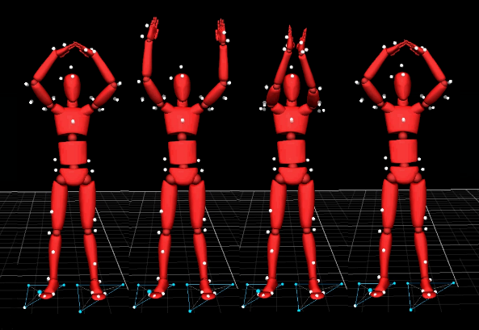

Bodily learning

Slide 10
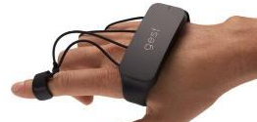
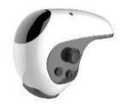
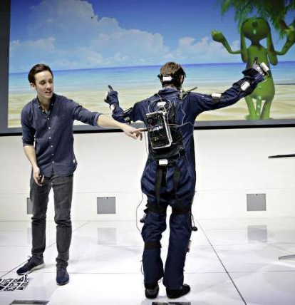
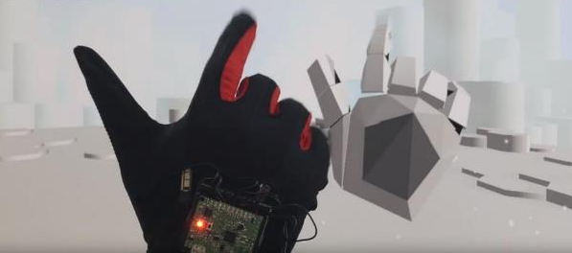
Controllere
Notes:
Alternative

Slide 11

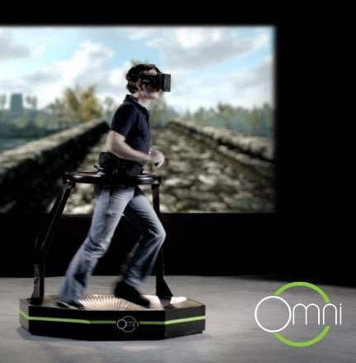
Controllere
Notes:
Alternative

Slide 12
VR game production

Slide 13
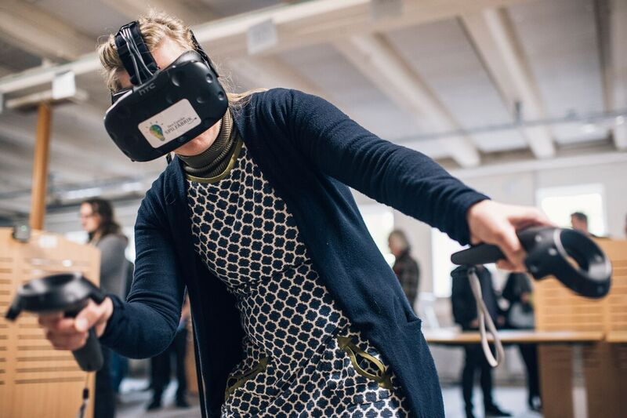
In-world test

Slide 14
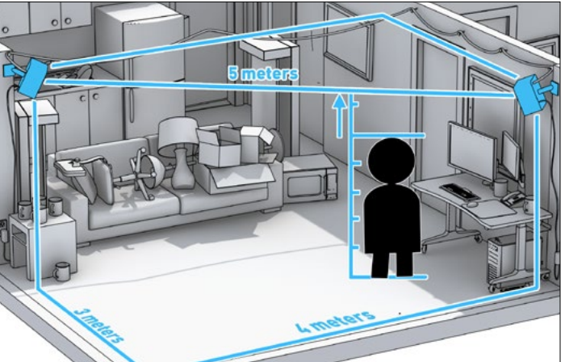
Room scale & height

Slide 15

Freedom of movement

Slide 16
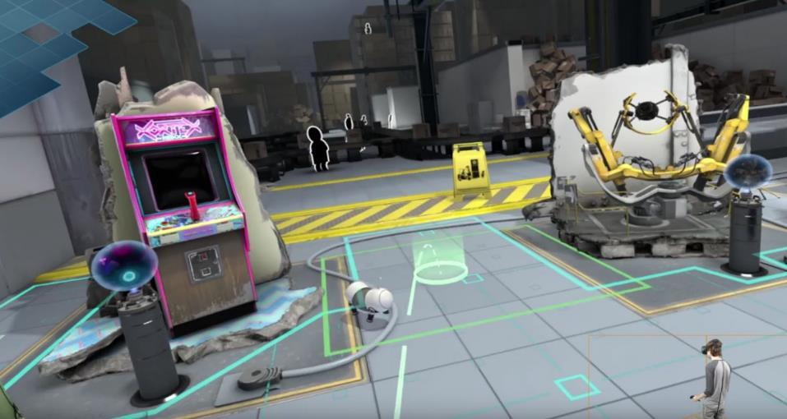
teleport

Slide 17
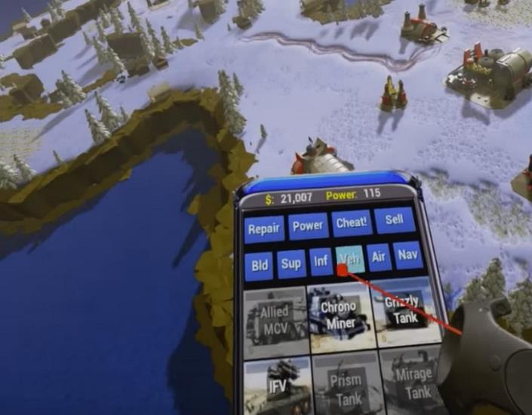
ui
Notes:
The UI design, options and mechanics should always be connected closely to the rest of the game

Slide 18
- Applied games -

Slide 19
Building blocks
Goal
Challenge
Interaction
Rules
Notes:
Chess, knight, rook, bishop, pawn

Slide 20
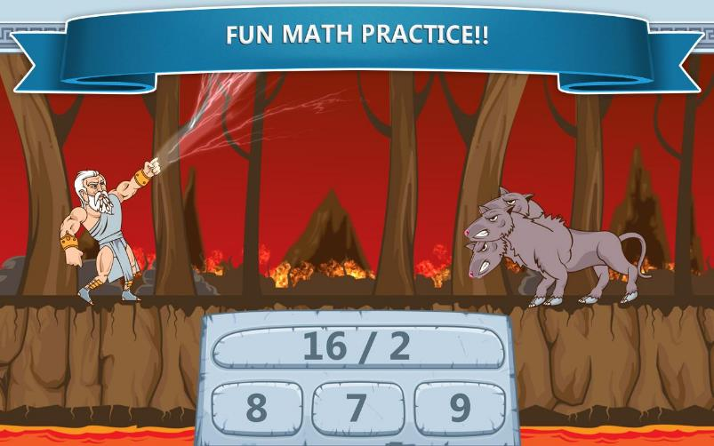
Zeus vs monsters
Notes:
1 dimensional

Slide 21
Building blocks
Goal
Challenge
Interaction
Rules

Slide 22
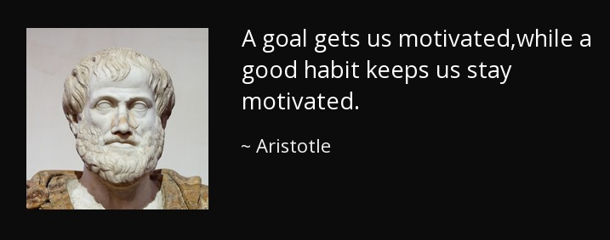
The goal should always be present
Notes:
Goal = Reward is the action toward the goal

Slide 23
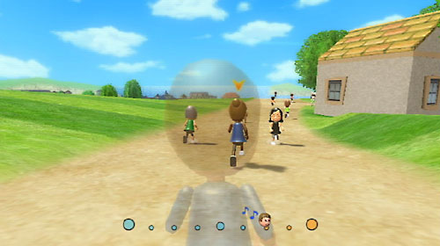
Wii Fit
Notes:
Problem is that it’s not breaking the 4th wall. Everything happens inside the game. The goal is not to play wii fit a lot, but to get a healthier life.

Slide 24
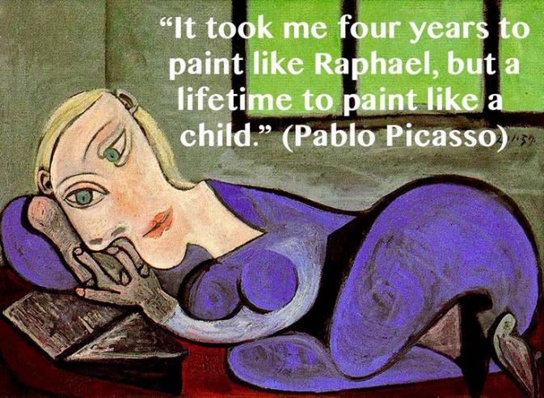
Make your own consistent rules
Notes:
Rules makes the universe believable, and makes you care about the game

Slide 25
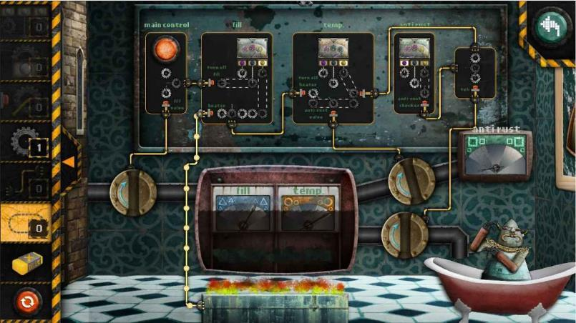
machineers
Notes:
Lohika, edutainment

Slide 26
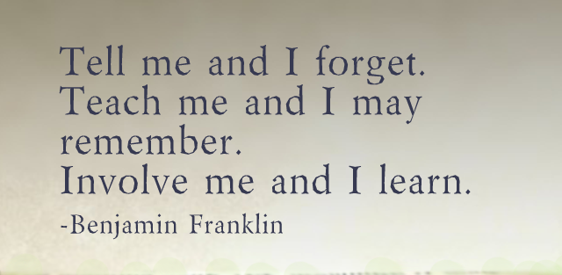
Involvement requires a meaningful Challenge
Notes:
Challenge are in games often the same as progress

Slide 27
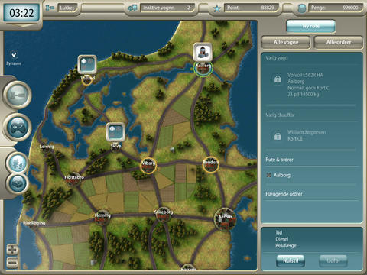
Cargo dynasty
Notes:
Tur Forlag & Tranportssektorens uddannelsesfond, edutainment

Slide 28
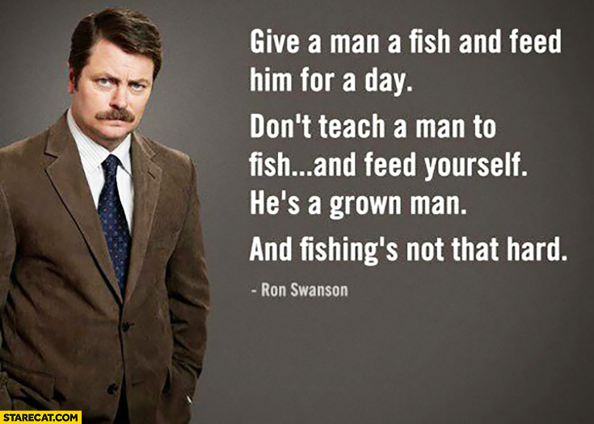
Interaction means DIY
Notes:
Interaction needs to be closely connected to all aspects of game, Nick Offerman.
Figuring out what to do is a huge part of learning.

Slide 29
- The Future of applied games -

Slide 30
Game categories
Industry
AAA
Indie
Tool
Entertainment
Innovation & Art
Notes:
Call for Money – recycled warfare

Slide 31
Next level applied games
Industry
Value
AAA
Indie

Slide 32

Next generation
Notes:
1 +1, advergame. Something hard made look easy. Lacks the indie part. Hard because of the competition.
Goal – keeps motivated
Interaction – no need to explain
Challenge - competition
Rules – have fun

Slide 33
the true future of applied games
On-Brand
Learning
New idea & tech
Rewards
Updates
Multi
Notes:
Updates regarding newest trends and user feedback

Slide 34

game of life
Notes:
Spend more time with family, healthy, career, friends, find love

Slide 35

Game of business

Slide 36
- Examples -

Slide 37
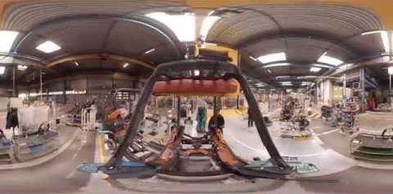
showcasing factories
Notes:
Toyota-factory. Adding an extra layer. The purpose is to save a physical visit.

Slide 38

Smart road
Notes:
Gaming chair: Racing Cube + wheel, pedals, shifter

Slide 39
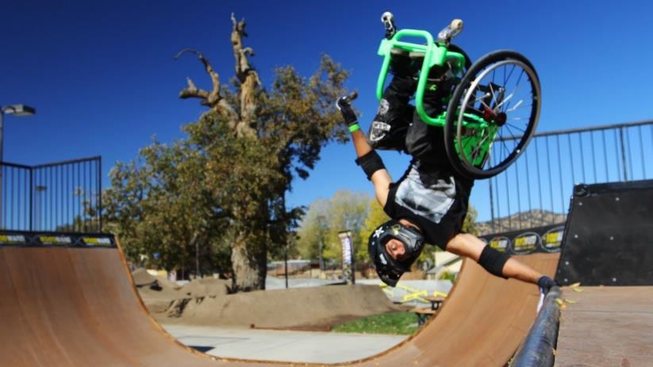
Embrace what you are
Notes:
Bound to a chair

Slide 40

Social anxiety
Notes:
Immersiveness makes the body react stronger

Slide 41

Conquer your fear
Notes:
Stomach drop feeling like with the plank experience

Slide 42

Life hack
Notes:
Hypnosis kan make your body take action and move of its own.

Slide 43
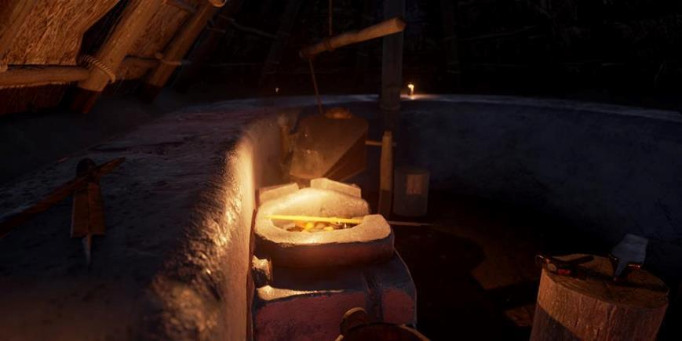
Become a part of history
Notes:
Being actual present at a place in time will make it easier for you to understand on a deeper level.

Slide 44

?
Notes:
Spørgsmål?

